Slide 1
Social Buzz Analysis
By: Wajiha Ahmed

Slide 2
Today’s Agenda
Project Recap
Problem
The Analytical Team
Process
Insights
summary

Slide 3
Project Recap
Social Buzz is fast growing technology unicorn that need to adapt quickly to its global scale. Accenture has begun a 3 month
ROC focusing on these tasks:
An audit of their big data practice
Recommendations for a successful IPO
An analysis of their content categories that highlights the top 5 categories with the largest aggregate popularity

Slide 4
Over 100000 posts per day
36,500,000 pieces of content per year!
But how to capitalize on it when there is so much?
Analyze to find Social Buzz:
Top most Popular category of content
Time of more traffic
Famous Reaction and Content Type
Problem

Slide 5
Analytical Team
Andrew Fleming (Chief Technical Architect), Marcus Rompton (Senior Principle),
Wajiha Ahmed(Data Analyst)

Slide 6
Data Understanding
Data Cleaning
Data Modeling
Data Analytics
Data Insights
Process

Slide 7
Analysis

Slide 8
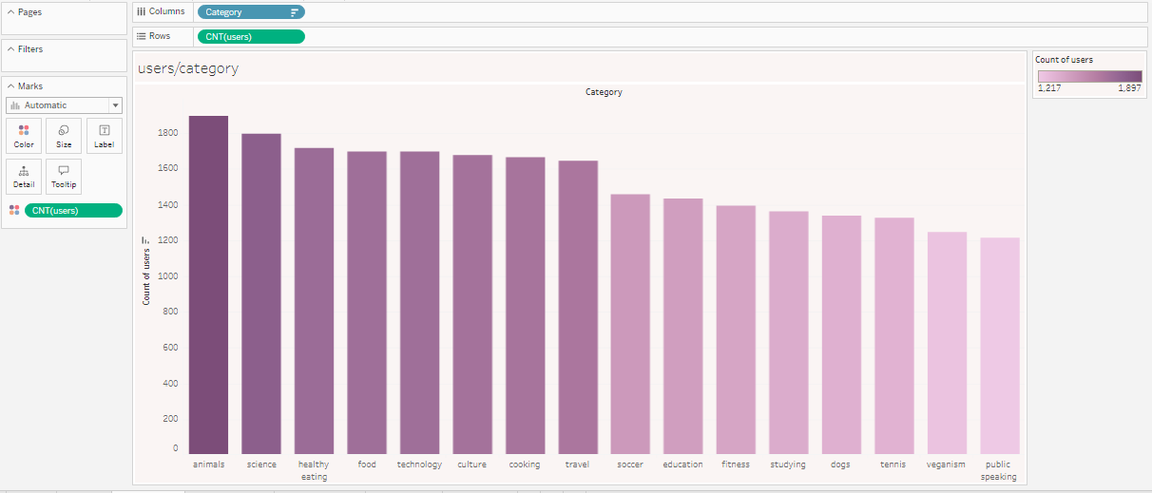
Popular Categories
Top 5 popular categories in users are:
Animal
Science
Healthy Eating
Food
Technology
While publics speaking is among low view category.

Slide 9
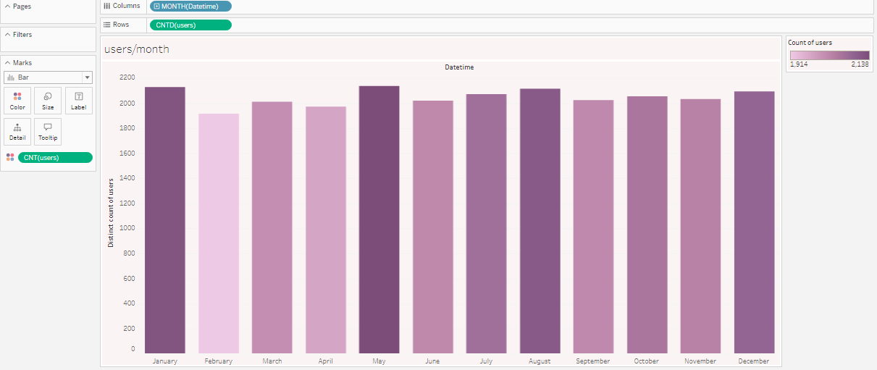
Mostly Traffic on which month
January, December ,May and August have more traffic
February has low traffic.

Slide 10
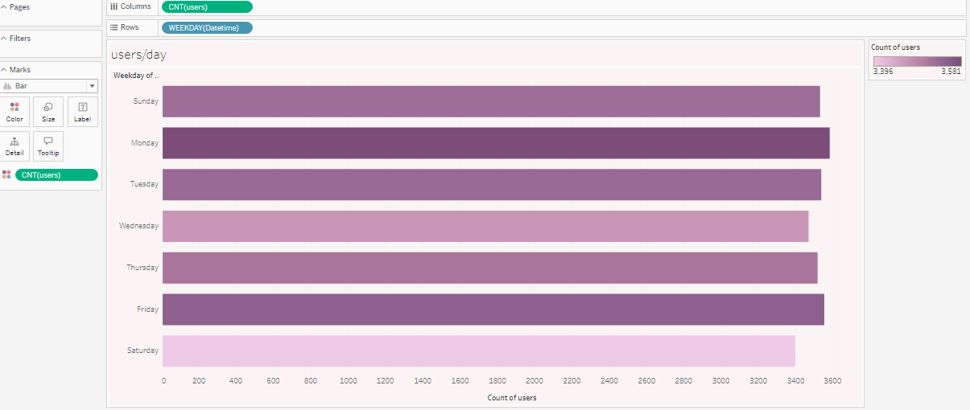
Which day of week has more traffic
Monday, Tuesday, Friday and Sunday has more traffic
Saturday has low traffic

Slide 11
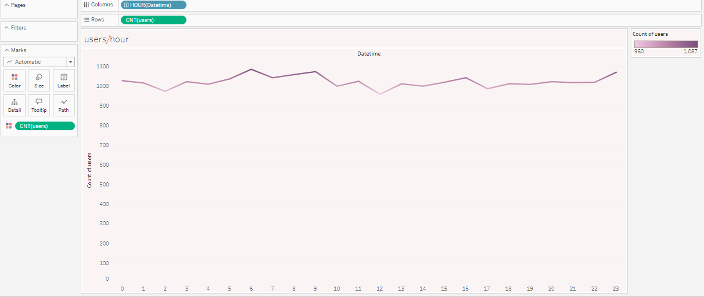
Which hour of day has more traffic
6 AM and 9 AM has more traffic.
12 PM has low traffic

Slide 12
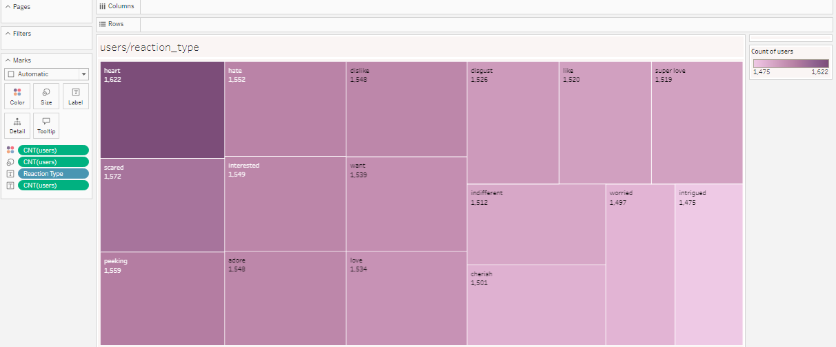
Popular reaction type
Heart ,Sacred and peeking are among popular reaction in users.

Slide 13
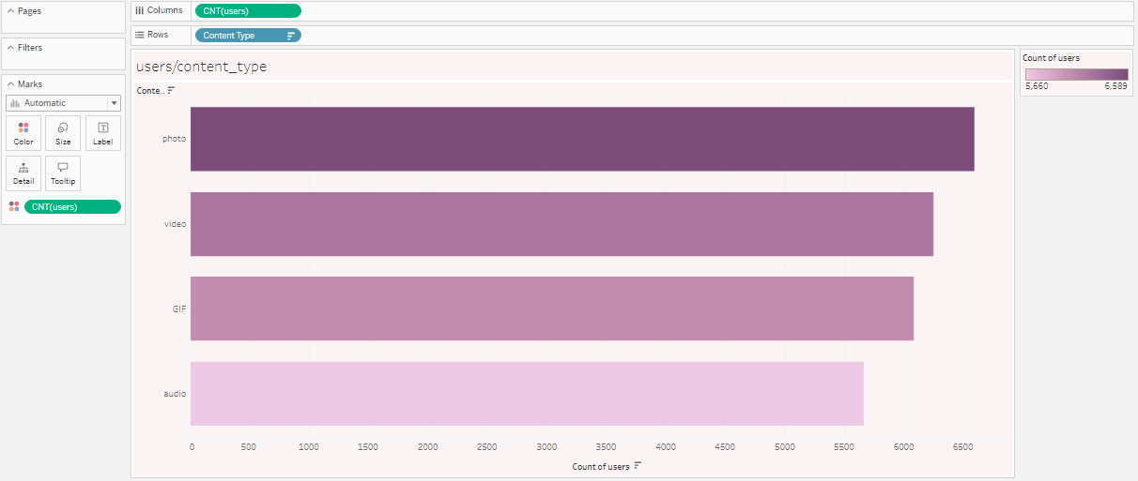
Popular content type
Photo and videos are more famous in users that GIF and audio

Slide 14
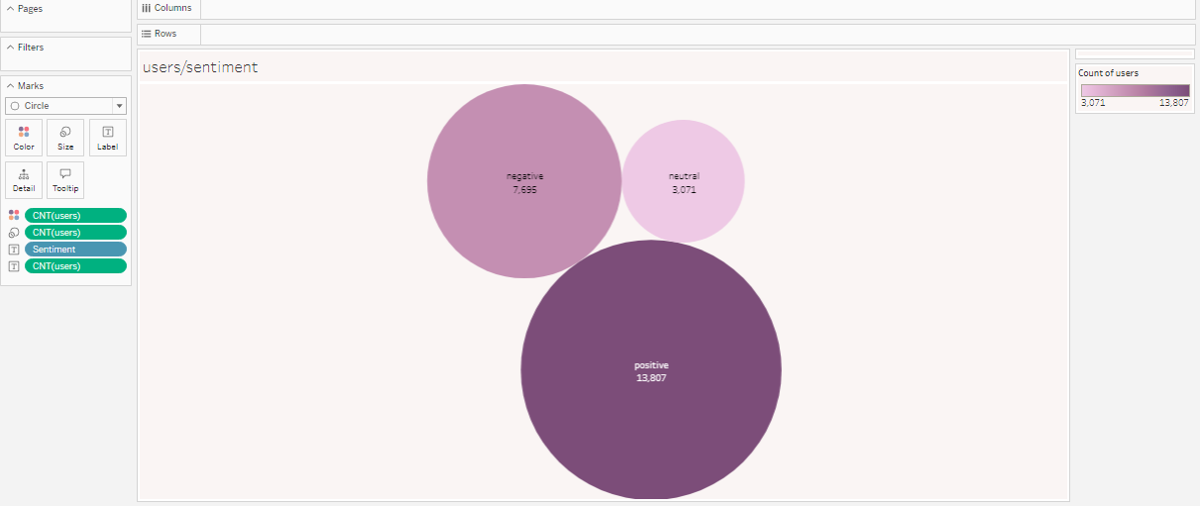
Sentiment
Mostly people have positive sentiment.

Slide 15
Animal, Science ,healthy eating, food and technology are among the most popular categories so its mean that users like content about “real-life” ,”factual” and “healthy eating”.
January, Monday, 6 AM and 9 AM are the time of more traffic.
Photo and video are among famous content type in users.
By utilizing these analysis we recommended Social Buzz that you should create a campaign and work with Rea Life, Factual and Healthy Eating brands to boost your engagement of your users you should on-air these campaign in the format of phots and videos on January or Monday or 6 AM or 9 AM because theses are the areas of more traffic and you get more engagement on these areas.
Insights

Slide 16

Thank you

